Slide 1
Appalachian Regional Commission Overview
Notes:
Laura:
Hello and thank you for allowing us the opportunity to introduce you to the Appalachian Regional Commission and provide an overview of its many programs and initiatives. We hope that you come away with a better understanding of the role ARC plays in advancing opportunities and facilitating economic growth in the Appalachian Region.

Slide 2
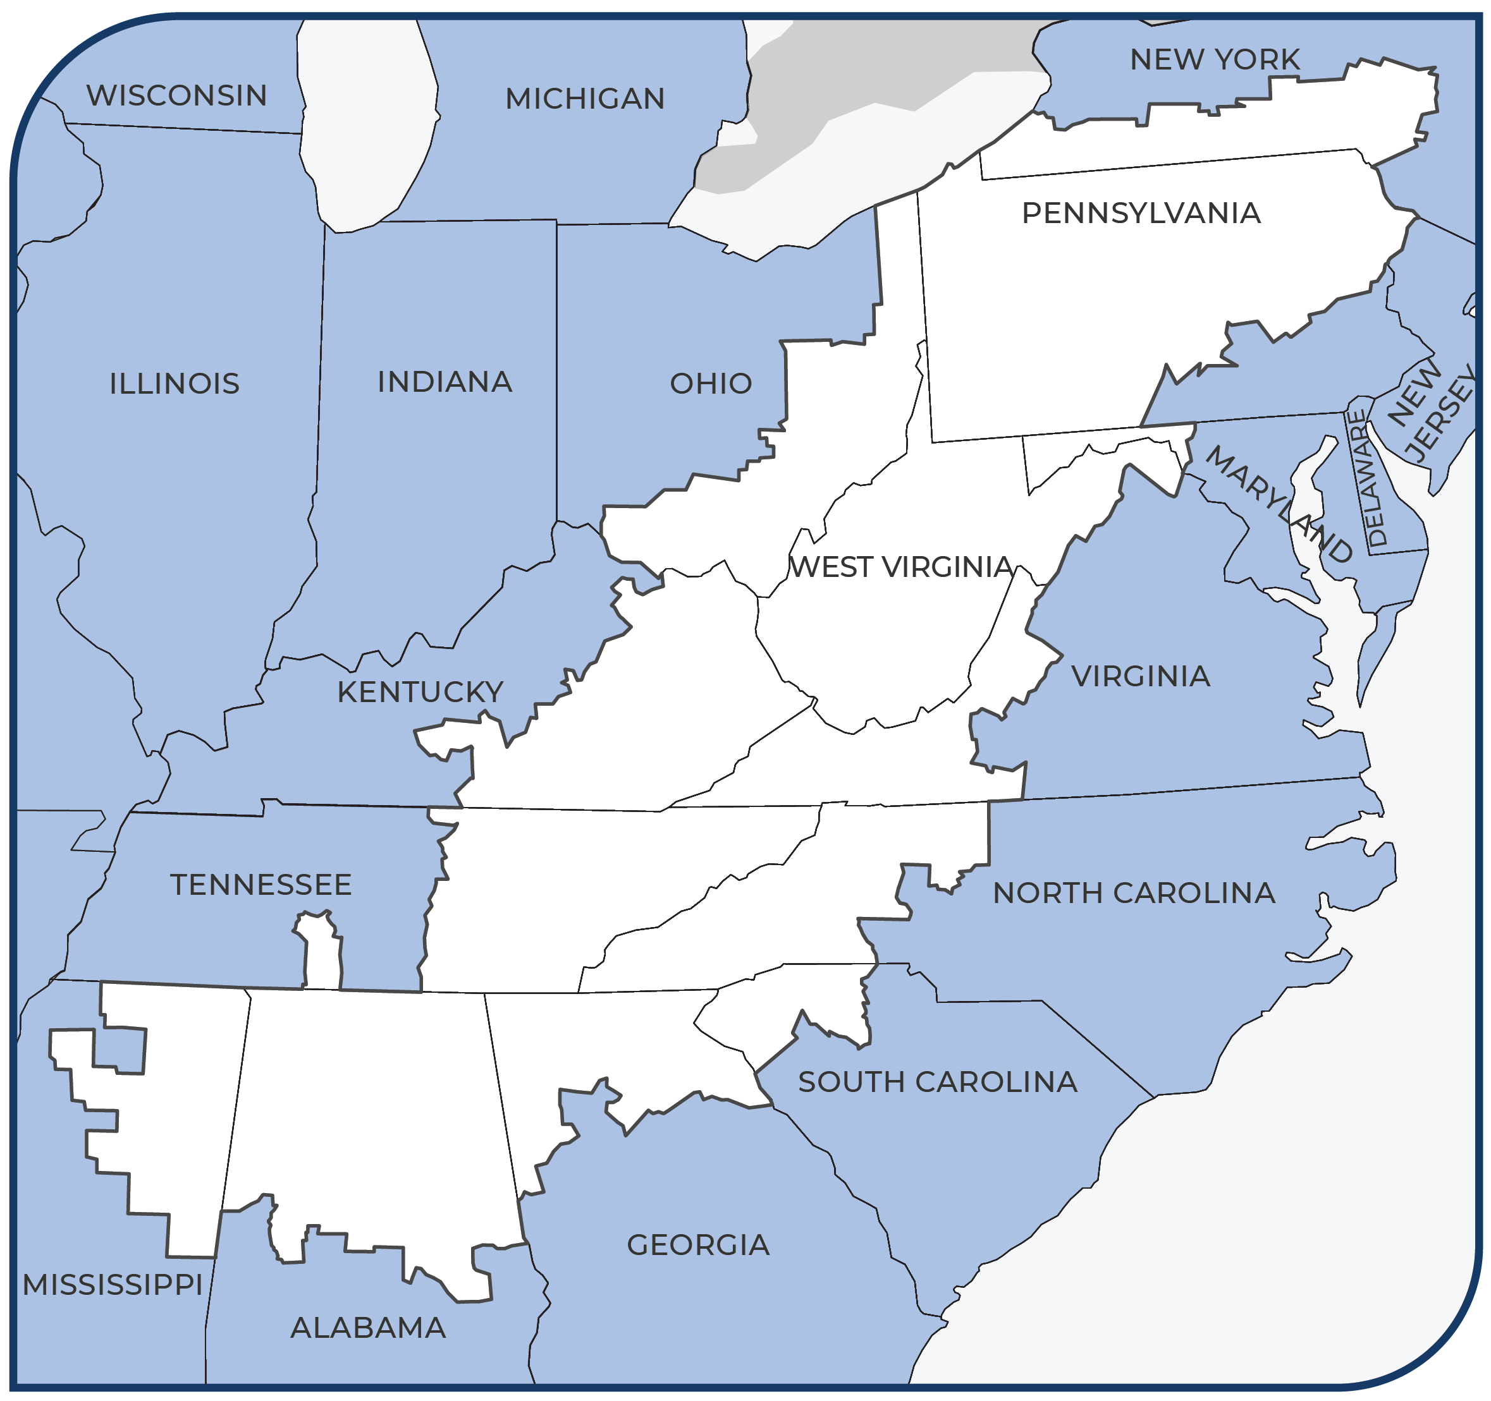
Appalachian Regional Commission
Created in 1965
Federal, state and local government partnership
13 states
423 counties
206,000 square miles
26 million people
74 area development districts
Notes:
Lexi:
The Appalachian Regional Commission, often referred to by its acronym ARC, has a long history and an extensive footprint. Formed in 1965 in conjunction with the passage of the Appalachian Regional Development Act (ARDA), ARC has since aimed to address the persistent economic disparities that exist in Appalachia with a strategic approach that relies on federal, state, and local leadership and collaboration.
This map depicts the outline of ARC's service jurisdiction – it is "Appalachia", as defined by ARDA, and consists of all of West Virginia and parts of 12 other states, from NY all the way down to MS.

Slide 3
Appalachian Regional Commission
ARC VISION STATEMENT
Appalachia is a region of great opportunity that will achieve socioeconomic parity with the nation
ARC MISSION STATEMENT
To innovate, partner and invest to build community capacity and strengthen economic growth in Appalachia
Notes:
Lexi:
ARC's Vision and Mission Statements.
ARC's Vision Statement, in short, is a declaration of what we know to be true for the Region and what we see for its future.
Our Mission Statement tells you how we're going to get there.

Slide 4
Unique Structure
Federal
Federal Office Staff
State
State Governors/Alternates
State Program Managers
LDDs
Commission
Executive Director
Commission Staff
Federal Co-Chair appointed by the President
State Co-Chair Representing State Interests
Notes:
Laura
ARC has a structure that is unique and that fosters partnership and collaboration -
We have Federal Co-Chair who represents the interests and priorities of the Federal Government as well as a State Co-Chair who represents the collective interests and priorities of all 13 States.
State Governors or their Alternates communicate individual priorities and play active roles in commission proceedings.
Then we have the State Program Managers, who run ARC programs in each respective state, while the local development districts, or LDDs, promote community awareness and provide ground-level support to ARC applicants and other key stakeholder groups.
The Commission itself provides framework and accounts for the administration, enabling the joint efforts of federal and state parties to take place in coordination with one another.

Slide 5
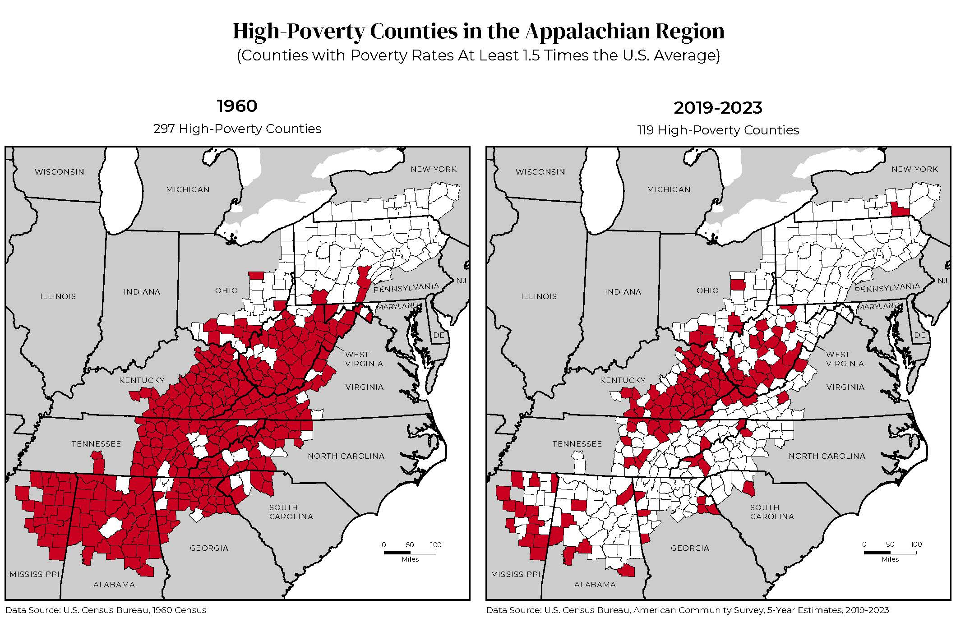
Notes:
Lexi:
To give you an idea of what Appalachia was facing in the 1960's as well as the progress that has been made since ARDA came into effect, we have here two maps that illustrate the level of distress the Region was experiencing, both then and now (or at least up to very recently). The counties in red are those that have been deemed "high-poverty counties" according to the US Census Bureau, with poverty rates at least 1.5 times the US average.
It is no wonder that President Kennedy used his executive authority to take action, forming a commission to evaluate the needs and challenges of Appalachia and to use those findings to develop a strategic and comprehensive plan for economic remediation. It is also no wonder why ARDA remains in effect today.
For, as you can see, despite having made great strides to alleviate the economic hardship faced by the Region's most impoverished communities, we still have a ways to go.

Slide 6
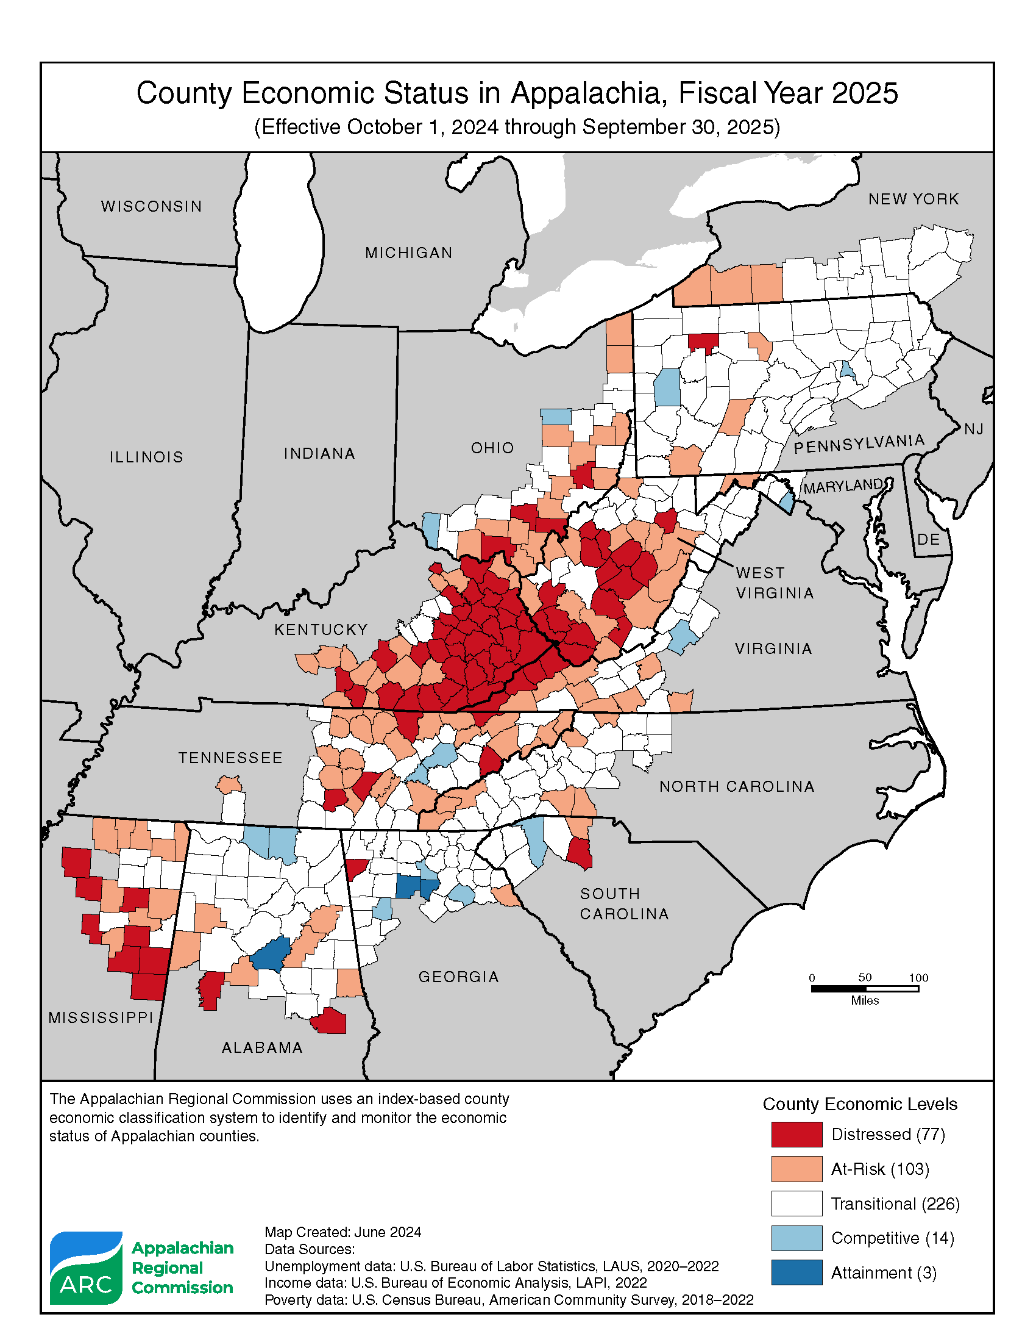
County Economic Status, FY 2025
ARC’s five county economic status designations
Distressed: The most economically depressed counties, ranking in the worst 10% of the nation's counties
At-risk: Counties at risk of becoming distressed
Transitional: Counties transitioning between at-risk and competitive status.
Competitive: Counties able to compete in the national economy but don’t rank in the highest 10% of the nation's counties.
Attainment: The economically strongest counties, ranking in the best 10% of the nation's counties.
Notes:
A similar image can be seen here. So this is according to ARC's own Economic Classification System, which analyzes three-year average unemployment rates, per capita market income and poverty rates to determine county status designation – according to these metrics, only 77 counties were designated as distressed in FY 2025 - this is the lowest level recorded in the 19 years of ARC’s index system.
You’ll notice that there are other economic status indications noted here as well – these are significant, not only because they indicate county-level progress or change that takes place in the region from one year to the next but also because these designations determine the required match ratio for any project that receives grant funding. You’ll find much more on match rules and requirements on our website.

Slide 7





ARC's Strategic Goals
Building Appalachian Businesses
Building Appalachia’s Workforce Ecosystem
Building Appalachia’s Infrastructure
Building Regional Tourism and Culture
Building Community Leaders and Capacity
Notes:
Lexi:
There are five core investment areas that ARC has identified through its strategic planning process as imperative to fulfilling its mission of helping Appalachia achieve economic growth and prosperity. Written out on the slide you can see each listed -
An understanding of ARC's strategic goals is significant, not only for those looking to learn more about ARC, but also for those looking to receive project funding as we ask prospective applicants to clearly identify the ARC goal their project serves to advance. Let's go through these goals in just a little more detail -

Slide 8
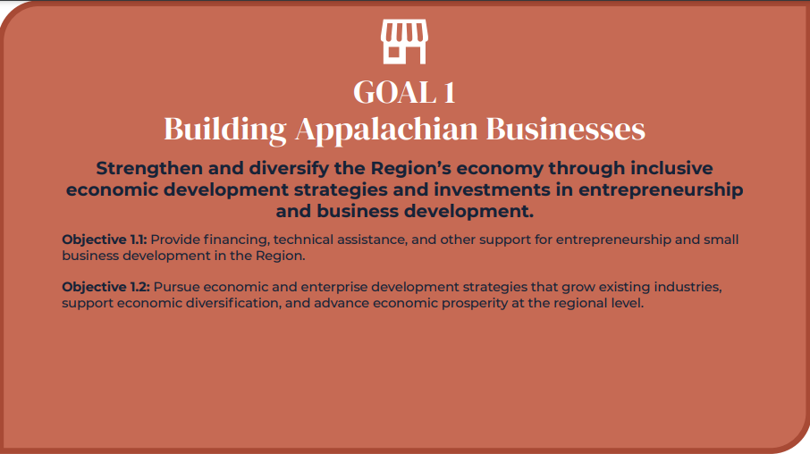
Notes:
Laura:
The first goal of ARC's current strategic plan is "Building Appalachian Businesses."
The presence and success of small businesses have a huge impact on local, regional, and indeed, national economies. In fact, the Small Business Association (SBA) reported that, in the US, small businesses "create two-thirds of net new jobs" and "account for 44 percent of U.S. economic activity". (Jan. 2019 https://advocacy.sba.gov/2019/01/30/small-businesses-generate-44-percent-of-u-s-economic-activity/)
In Appalachia, entrepreneurship/business ownership also resonates with the strong, independent, and creative spirit that characterizes the residents within, increasing the relevance and significance of targeted investments in this space.

Slide 9
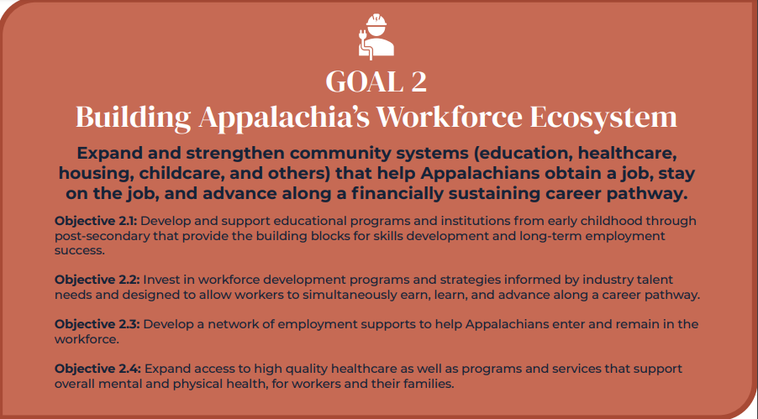

Notes:
Lexi:
The second goal of ARC's strategic plan is "Building Appalachia's Workforce Ecosystems." This goal is predicated on a belief that economic vitality is dependent on investments in human infrastructure that address all aspects work ability and opportunity – building networks, acquiring skills and education, having access to support systems. Gone are the days when education and skill development were thought to be enough – a whole systems approach to developing and maintaining an active and competitive workforce provides the basis for ARC's 2nd strategic goal.

Slide 10
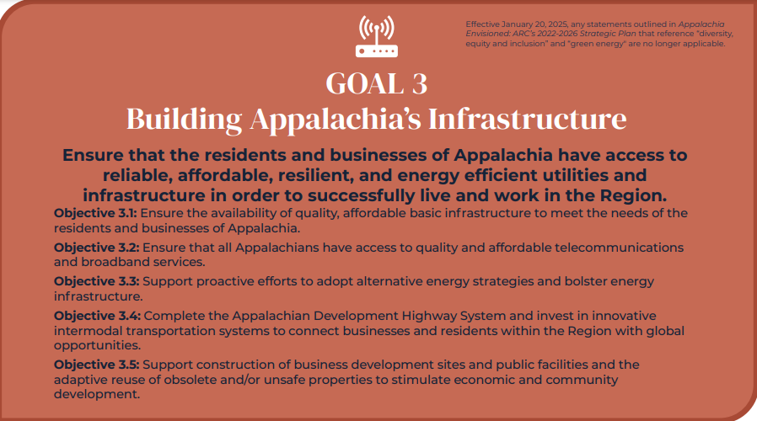
Notes:
Laura:
We know that investments in infrastructure are imperative to economic stability and progress – this has been the case long before the advent of ARC and will likely never change. Revolutionary changes in energy, mobility, and digitization, however, have altered the infrastructure landscape, expanding our notion of what we consider to be critical investments in this space.

Slide 11
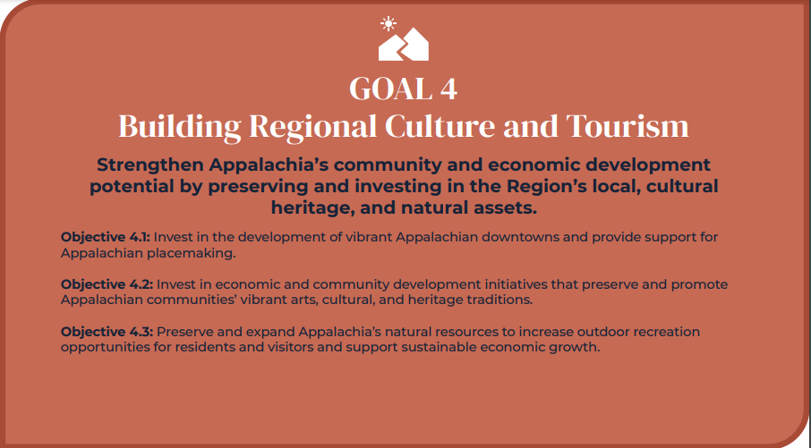
Notes:
Lexi:
Appalachia is particularly suited for an economic development strategy that seeks to build upon cultural heritage and natural assets – it is a Region steeped in tradition, unique in identity, and rich in natural beauty. It's no surprise that projects in this space are ever-increasing, capitalizing on different strengths and encompassing a wide-array of activities including art, music, culinary tours, and outdoor recreation.

Slide 12
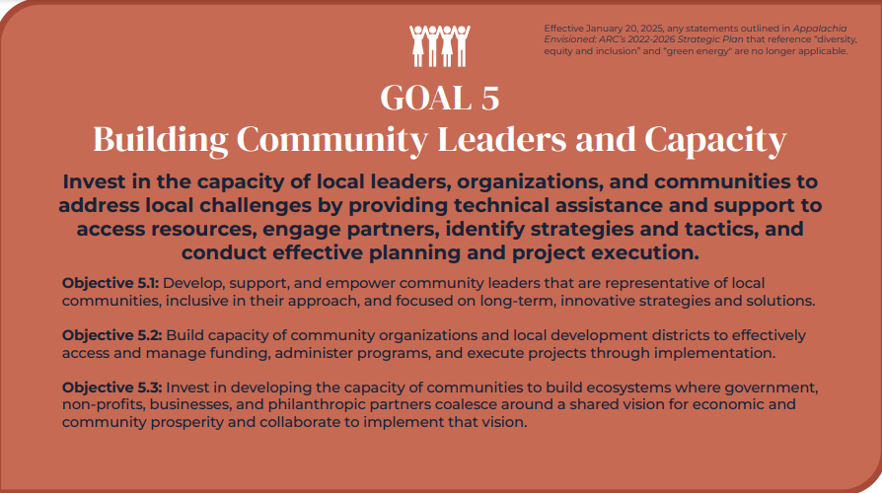
Notes:
Laura:
ARC believes in empowering local communities – providing local leaders and organizations with the skills, abilities, and resources necessary so that they can develop, implement, and sustain their own economic and community development objectives. We hear time and time again from our stakeholders that capacity building at the local and regional level is imperative to building economic resilience and self-reliance in our Appalachian communities.

Slide 13
Area Development: ARC's Base Funding Program
Notes:
Lexi:
Now we'll get into the different funding opportunities. We'll start with Area Development.

Slide 14
Area Development Basics
Area Development is formula-driven and state-led
ARC provides the framework for all State Programs
ARC works in partnership with State Partners and LDDs to provide a variety of technical assistance offerings
ARC administers all non-construction grants and manages the BA program in the administration of construction grants
Notes:
Lexi:
Area Development is ARC's base program.
It is formula driven and state led – this means that congress appropriates a certain amount of money each year to ARC which is then divided among the states. The amount that each state receives is based on a formula that takes a number of different factors into account (i.e., size, population, number of distressed counties, etc.) – it is then further adjusted by congressional priorities which are generally based on subregion. States are able to use money from their AD funds to invest in projects that align most closely with the priorities of their state, guided of course by ARC’s core mission and values.
When it comes to post-award administration, it should be noted that while ARC manages all non-construction grants, the management of construction project grants is carried out by a basic agency partner (either federal or registered state) on behalf of ARC.

Slide 15
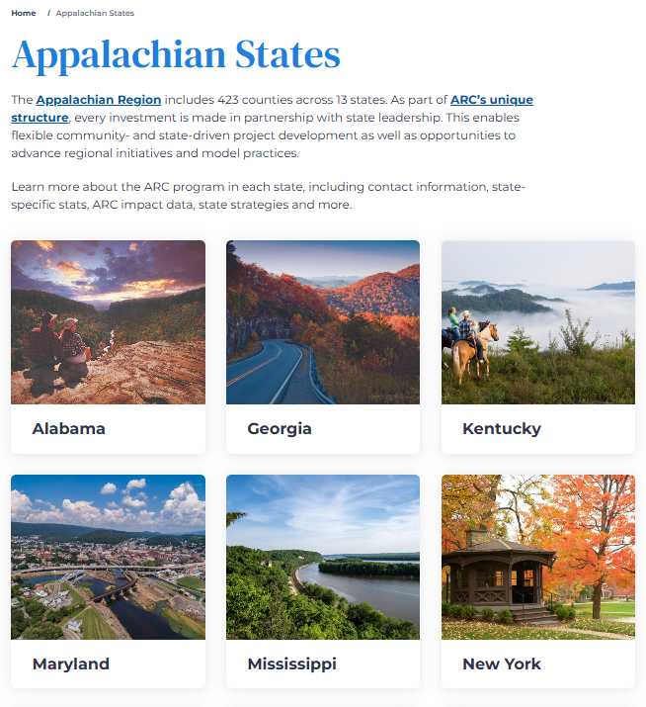
State Information Annual Strategy Statement and 4-Year Plan
Notes:
Laura:
This image shows how state specific information is organized on our website. This is where you can find a lot of useful information when it comes to your home state – not least of which are state strategy statements and four-year plans. These can be used to develop a general understanding of state priorities and processes as well as for reference when specifying project alignment and advancement (these things must be cited in ARC applications).

Slide 16
Goal 1: Kentucky’s Investment in Building Appalachian Businesses through entrepreneurial and business development strategies that include expansion of tourism, manufacturing, and AgriTech in Kentucky’s ARC region.
Goal 2: Kentucky’s Investment in Workforce Ecosystems through education and technical training programs for workers in Appalachian Kentucky. Also, assisting the region in accessing quality health care and preventative programs that result in better health outcomes, as well as supporting a healthy workforce.
Goal 3: Kentucky’s Investment in Community Infrastructure through maintenance and expansion of Kentucky’s ARC Region’s water and wastewater systems and broadband and telecommunication systems.
Goal 4: Kentucky’s Investment in Regional Cultural and Tourism by focusing on infrastructure assets for Kentucky’s mountain trail systems and value-added tourism opportunities highlighting Kentucky’s natural assets, historical sites, and heritage.
Goal 5: Kentucky’s Investment in Building Community Leaders and Capacity by creating leadership development opportunities to spark entrepreneurship and cultivate dynamic young leaders to stay and invest in the region.
Notes:
Laura:
This was pulled from Kentucky's current ARC development plan – while you can see that it closely aligns the strategic goals of ARC shared earlier in the presentation, additional detail may be found in the objectives and strategies for implementation that correlate with and drive each one of these goals.
For example, for the goal of Building Appalachian Businesses, KY notes the specific expansion of tourism, manufacturing, and AgriTech. For Goal #4, Regional Culture and Tourism, KY mentions infrastructure assets for its mountain trails systems.

Slide 17
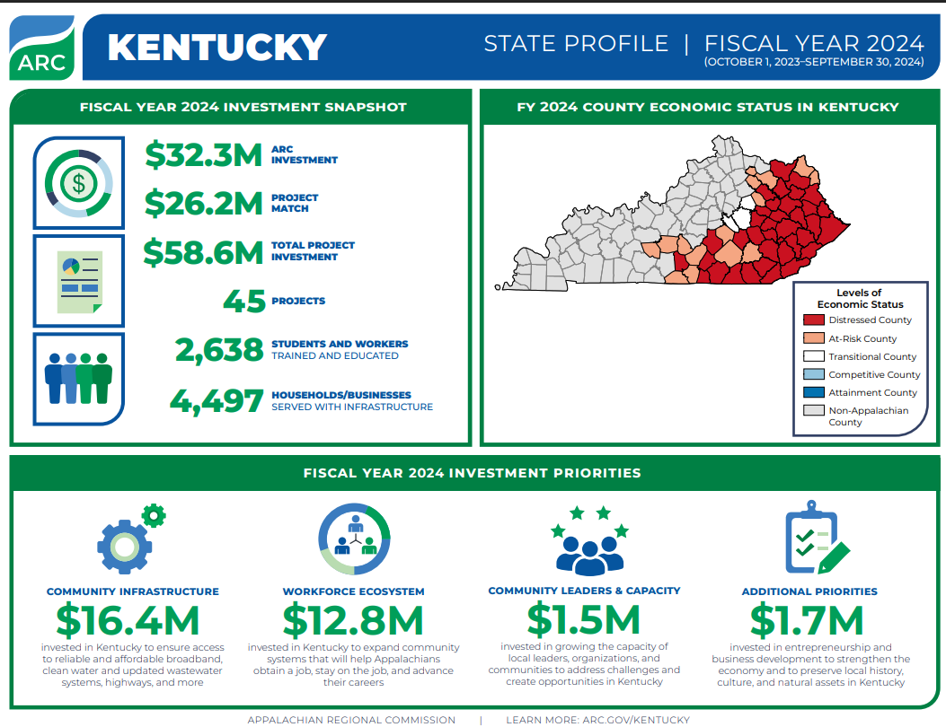
Notes:
Lexi
And for a quick investment overview, or snapshot if you will: In partnership with the Kentucky Department for Local Government, ARC is supporting 45 projects in Kentucky totaling $32.3 million in fiscal year (FY) 2024. These investments are benefiting the 1.2 million residents in Kentucky’s 54 Appalachian counties.

Slide 18
Kentucky State Partners and Key ARC Contacts
Governor’s ARC Representative:
Matt Sawyers, Commissioner email: Matt.Sawyers@ky.gov
Kentucky Department for Local Government 100 Airport Road, Third Floor Frankfort, KY 40601
Interim ARC State Program Manager:
Whitney Mendiondo, Interim ARC Program Manager email: Whitney.Mendiondo@ky.gov
Kentucky Department for Local Government 100 Airport Road, Third Floor Frankfort, KY 40601 502.892.3476
Notes:
Laura (or Whitney?)
While State contacts are listed on ARC's website, we have also included them here for easy reference. Matt Sawyers represents KY as their state alternate and speaks on behalf of the governor in all commission affairs and proceedings. While he and his contact info are listed, it is really the State Program Manager who you should first go to for any questions related to ARC – potential projects, application processes, current programs, etc. Whitney Mendiondo is currently standing in as acting Program Manager for the State of KY and her information is also listed on this slide.

Slide 19
Kentucky's Area Development Districts
Edmonson, Hart, Metcalfe, Monroe,
Barren River Area Development District
270.781.2381 - http://www.bradd.org
Floyd, Johnson, Magoffin, Martin, Pike,
Big Sandy Area Development District
606.886.2374 - https://bigsandy.org/ Clark, Estill, Garrard, Lincoln, Madison, Nicholas, Powell,
Bluegrass Area Development District
859.269.8021 - http://www.bgadd.org
Fleming, Lewis, Roberston,
Buffalo Trace Area Development District
606.564.6894 - http://www.btadd.com
Bell, Clay, Harlan, Jackson, Knox, Laurel, Rockcastle, Whitley,
Cumberland Valley Area Development District
606.864.7391 - http://www.cvadd.org
Boyd, Carter, Elliott, Greenup, Lawrence,
FIVCO Area Development District
606.929.1366 - http://www.fivco.org
Bath, Menifee, Montgomery, Morgan, Rowan,
Gateway Area Development District
606.780.0090 - http://www.gwadd.org
Breathitt, Knott, Lee, Leslie, Letcher, Owsley, Perry, Wolfe,
Kentucky River Area Development District
606.436.3158 - http://www.kradd.org
Adair, Casey, Clinton, Cumberland, Green, McCreary, Pulaski, Russell, Wayne,
Lake Cumberland Area Development District, Inc.
270.866.4200 - http://lcadd.org
Notes:
Laura (or Whitney?)
We had mentioned LDDs when talking about the unique structure of ARC but also wanted to include a list of those that are located in Kentucky. Referred here as Area Development Districts or ADDs – these are multi-county planning organizations that facilitate community-based, regionally driven, economic development. There are nine ADDs in the state of KY and 74 LDDs spread across the Appalachian Region. These are organizations that provide ongoing technical assistance and other support to ARC applicants and grantees in their jurisdiction – as such, they are another important source of help and information as it pertains to ARC funding.

Slide 20
Competitive Grant Initiatives
Notes:
Lexi:
Now, we've come to ARC's competitive grant initiatives - state program managers are still included throughout the screening and review process, though state discretion does not operate in the same way as it does for Area Development. While some state AD programs may be more competitive than others simply because expectations and requirements must be met and funding is limited, they are not competitive in the way they are vetted, scored, and selected.

Slide 21
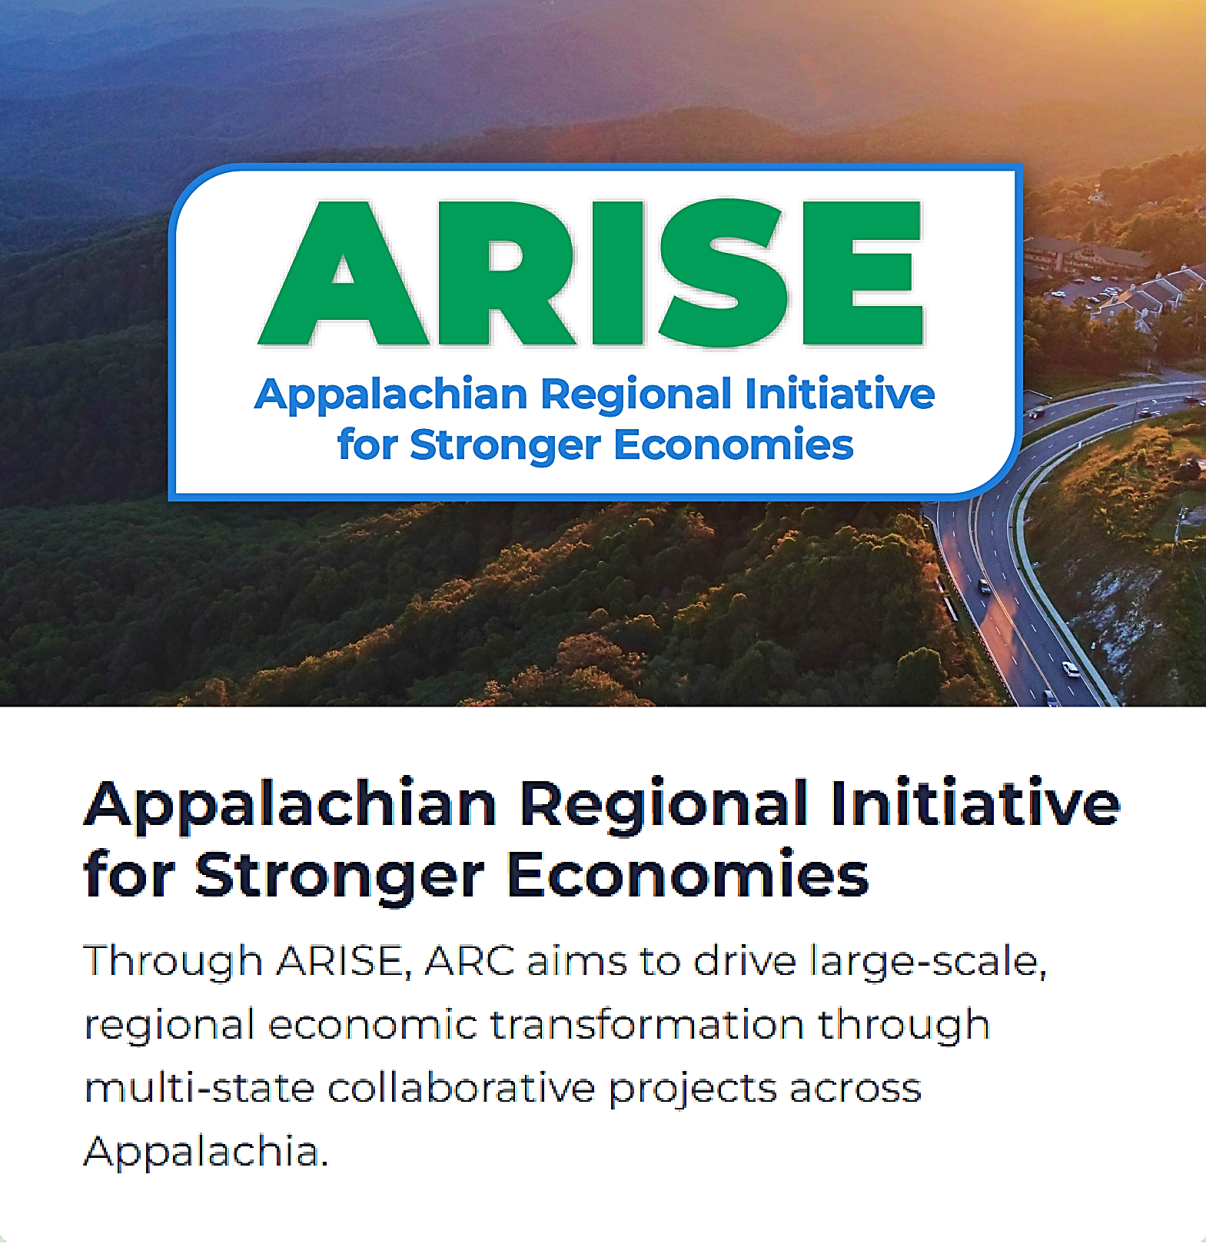
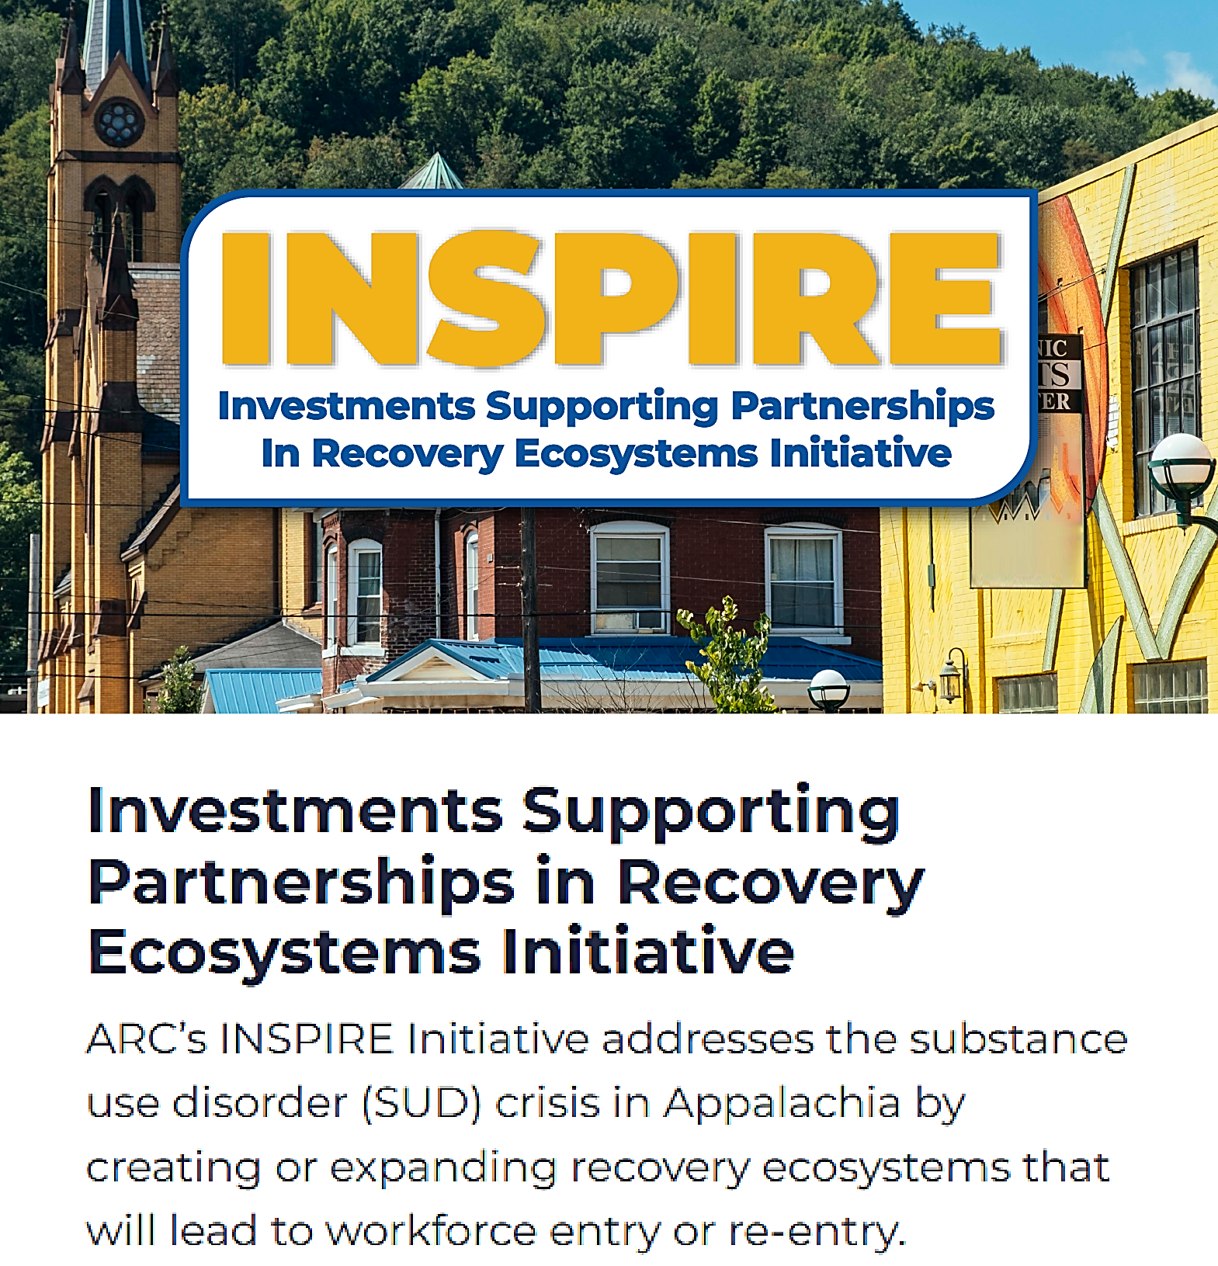
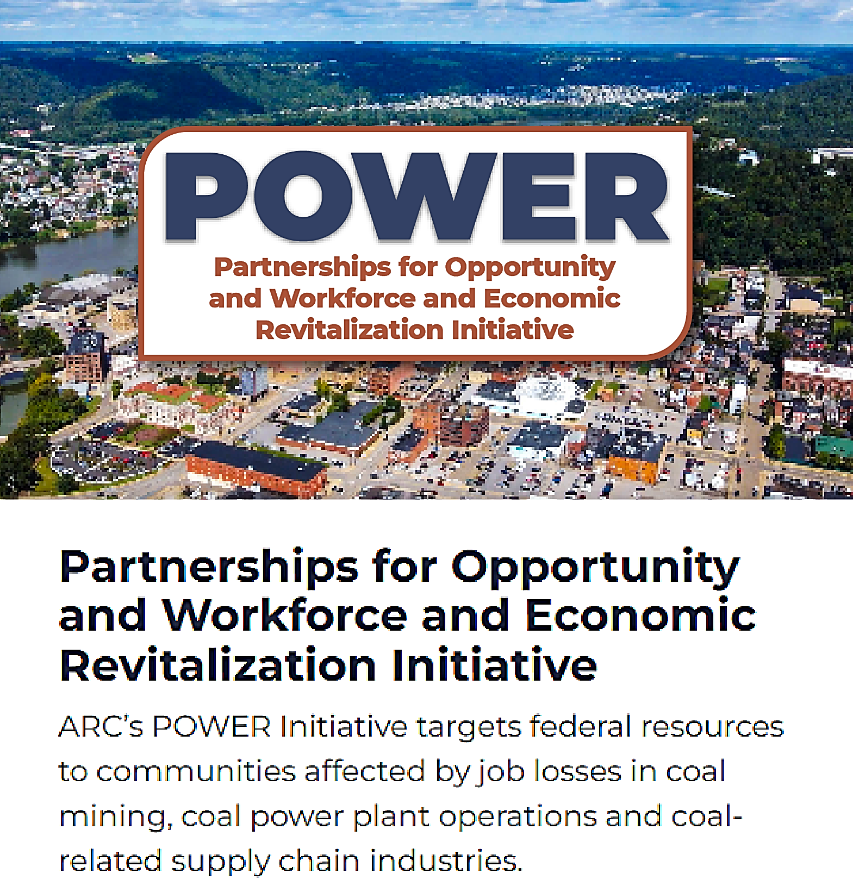

ARC Signature Initiatives
Appalachian Regional Energy Hub Initiative
For a complete list of ARC's grant programs, see
https://www.arc.gov/grants-and-opportunities/
Notes:
Laura:
Lets take a look at ARC's current offerings:
ARISE – semi-competitive, multi-state and transformative, all ARC project types are eligible, high-dollar awards: the 2025 ARISE NOSA release is expected before the end of the FY so make sure you keep an eye out (likely early September). Funding for this initiative was provided through 2026 and the NOSA has been approved for 25. We're just tying up a few loose ends and we'll be ready.
INSPIRE – competitive - Recovery-to-Work/SUD focus – all projects are workforce-based, often including supportive service components and the involvement of various partners within the recovery-to-work ecosystem. Applications from the latest round are under review and announcements are expected in early Fall (give or take). The cycle for this initiative generally opens in late January or thereabouts.
POWER – Coal communities, highly collaborative, prioritized project types include workforce training/diversification, developing industry clusters, entrepreneurship, broadband. The NOSA for this initiative was just released this month.
And finally, the energy hub.
The Energy Hub is a funding opportunity for eligible applicants to:
Conduct research on natural gas and natural gas liquid supply and demand opportunities; or
Support the implementation of an energy hub for hydrogen produced from natural gas using carbon capture technology.
This is a very specialized program with a narrowly defined set of project requirements. Please access the information on our website and in the program NOSA for details.

Slide 22
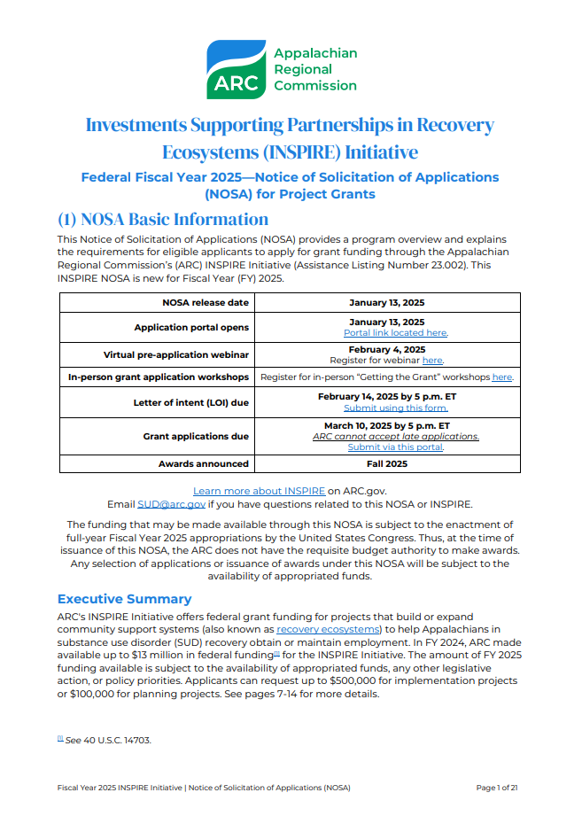
Program and Project Details
Found on the ARC website and within current NOSAs.
Notes:
Lexi:
Applicant and project eligibility, funding priorities and any nuances that exist for competitive programs are found within current year NOSAs. Of course, you can learn a lot from NOSAs of previous years as well as on ARC's website on appropriate program pages, such as award summaries, project type examples, etc. Its just important to keep in mind that changes occur from one year to the next – review and scoring criteria, funding amounts, timelines, even whether or not initiative will remain available – so while it's a good idea to reference back and start considering how you might develop your project or prepare your grant application, be ready to pivot as needed.

Slide 23
Applicable to all ARC Grant Programs
Eligible Grantees include:
Local development districts (LDDs)
Indian Tribes or a consortium of Indian Tribes
States, counties, cities, or other political subdivision of a state, including a special purpose unit of a state or local government engaged in economic or infrastructure development activities, or a consortium of political subdivisions
Institutions of higher education or a consortium of institutions of higher education
Public or private nonprofit organizations or associations
Eligible Projects must:
Target counties within the Appalachian Region as indicated by the Appalachian Development Act of 1965
Advance and Align with ARC/State Goals
Federal Requirements and ARC Policy:
ARC Code (including regulations on applicant match)
Title 2 of the Code of Federal Regulations (CFR), Part 200 (“2 CFR Part 200”)
Notes:
Laura:
A couple of important things to note as we conclude our summary of ARC's base and competitive grant programs pertain to basic eligibility factors and matters of policy that are applicable across the board.
First, grantee eligibility: as you look at the list of eligible grantees or those who may apply for funding, you may notice the omission of individuals and for-profits entities – this is because ARC does not award grants to individuals OR for-profits businesses.
And, as mentioned, in addition to aligning with ARC and Appalachian state goals for Economic Development, projects must also target counties within the Appalachian Region as defined by ARDA.
And finally, ARC derives all funding from the federal government – therefore, - all grants, contracts, and subawards are subject to the same rules and requirements that govern ALL federal awards and must comply with Title 2 of the Code of Federal Regulations (CFR), Part 200 (“2 CFR Part 200”). This is in addition to the requirements stipulated by ARDA, ARC Code, and other organizational policies.

Slide 24
Laying the Groundwork: What Makes a Strong ARC Proposal
Notes:
Lexi:
Now that we have a better idea of the various funding programs that ARC currently offers as well as basic eligibility and regulatory requirements for grantees, let's turn our attention to projects and discuss some of the key elements that ARC looks for in projects across the board. We'll start by re-establishing ARC's primary purpose, that which defines all approved ARC projects.

Slide 25
The "Economic Development Lens"
ARC places high-value on projects wherein the correlation with economic development is clear and made prominent.
All proposals are considered from the perspective of economic development and reviewed using this lens.
Notes:
Lexi:
Strong proposals will successfully demonstrate how projects support economic growth and development. While ARC acknowledges that economic growth and progress is irrevocably tied to other areas of community need and development (i.e. social services, health and housing, safety and well-being), key decisions are made based on data that is filtered through an economic development lens – what is the impact that this action or investment choice will have on the local, state, or regional economy?

Slide 26
State and Local Empowerment
Partnerships and Cross-Sector Collaboration
Economic Resilience and Diversification
Regionalism and Transformative Projects
Research, Innovation, Progress
Economic
Development
Notes:
Laura:
Going beyond the economic development lens: Folks often ask about the kind of projects ARC or ARC's Federal Co-Chair values most, if there are priority project types that may receive more favorable attention. While there aren't any specific kinds of projects that ARC prioritizes over others, there are certain overarching themes, programmatic elements, or aspects of project design that are deemed highly valuable in their contribution to the economic development of the Region and that can be considered priorities of the current leadership... you can see them here.

Slide 27
Strategic
Project aligns with the goals of the community and regional plans
Impactful
Project has specific performance targets aimed at helping Appalachia economically prosper
Collaborative
Project engages partnerships to achieve common or aligned goals
Project has a plan for maintaining the program or asset after the grant period has ended
Sustainable
ARC Project Fundamentals
Notes:
Lexi:
Similarly, ARC has also identified a number of basic elements that should be considered and included in the design of any project looking to receive ARC investment. As indicated in our strategic plan, ARC will continue to partner with state and local leaders to make more investments in Appalachia that are
Strategic and rooted in community needs and vision
Achieve greater impact and hold us accountable for results
Encourage collaboration and partnerships
Endure beyond the life of the grant and continue to support economic development growth and achievement well into the future

Slide 28
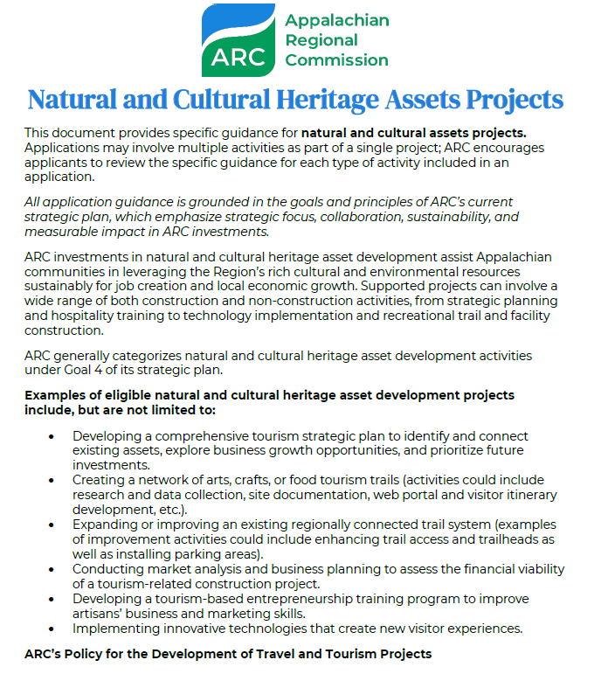
Project Type Guidance
Notes:
Laura:
To see how these fundamentals might be incorporated into projects and applications based on their type, consider reviewing these resource documents that are located in the applicant resources section of our website (we can show you where this lives towards the end of our presentation). In addition to the integration of key elements, each document also contains:
Project examples
Helpful resources
Other considerations
Again, keep in mind that competitive programs have additional specifications that are outlined in the current NOSA for each year – if going for a POWER INSPIRE ARISE or Energy Hub Grant, it is important that you refer first and foremost to the NOSAs for those initiatives and consult these documents to then aid or supplement that information.

Slide 29
ARC Partner Programs
Notes:
Laura

Slide 30

 | Recreation Economy for Rural Communities (RERC) | Local Food Local Places (LFLP)
Partnership with DOL, in collaboration with the DRA and the NBRC WORC is a competitive workforce grant program funded and reviewed by DOL with no match requirement Funding targeted exclusively to entities within the ARC region ARC provides technical assistance post-award for WORC grantees in the region www.arc.gov/WORC | Partnership of the EPA, ARC, and USDA, Forest Service Technical assistance opportunity (no associated funding) Focus: Helps communities create a Local Action Plans for Growing Outdoor Rec Economies Example Priorities from Local Action Plans: Connecting downtown to local natural assets Developing outdoor recreation-based entrepreneurship Building year-round outdoor recreation amenities https://www.epa.gov/smartgrowth/recreation-economy-rural-communities | Partnership of the EPA, ARC, and Superfund Program Technical assistance opportunity (no associated funding) Focus: Helps communities create a Local Action Plans for Growing Local Food Economies Example priorities from LFLP include: Farmers’ markets Improving access to local food Commercial kitchens/food hubs https://www.epa.gov/smartgrowth/local-foods-local-places
Notes:
Laura:
Workforce Opportunities for Rural Communities, also known as WORC, is also a competitive program however, it differs from the other initiatives we’ve discussed in that it is funded and administered by the Department of Labor, not ARC.
The primary focus of WORC 7 is to provide industry-aligned training and workforce development services to eligible participants to enable them to obtain family-sustaining employment opportunities
The next two programs listed here, Recreation Economies for Rural Communities and Local Foods Local Places are ARC/EPA partnership programs that fund technical assistance and planning activities to help selected communities develop plans to expand on outdoor recreation and local food systems as an economic drivers.

Slide 31
Other ARC Programs, Activities, and Areas of Interest
Notes:
Lexi:
Moving on from ARC's principle grant and funding programs, we will now direct our focus on some of the other opportunities and resources that ARC offers that serve to advance its vision for Appalachia.

Slide 32




Academies and Institutes
https://www.arc.gov/academies-and-institutes/
Appalachian STEM Academy
Middle and High Schools Students/Teachers
Application Window: Early Winter
Appalachian Entrepreneurship Academy
High Schools Students
Application Window: Early Winter
Appalachian Collegiate Research Initiative
College Students
Application Window: Early Winter
Appalachian Leadership Institute
Appalachians interested in community/economic development
Application Window: Spring
Notes:
Lexi:
ARC hosts several academies and institutes for students and adults in STEM education, entrepreneurship development, applied research, and community leadership. These are individual capacity-building programs designed to strengthen current leadership with increased skills, knowledge, and access to resources while preparing the next generation of leaders to take the Region even further into the future.
Each learning track within our Academies and Institutes program offers on-site, experiential learning and capacity building opportunities for individuals of varying ages. They are competitive in that all four incorporate application, review, and selection processes prior to being approved for admission.
For more information on our Academies and Institute Program, please visit the website noted on this slide, also found on the ARC website.

Slide 33
Research and Evaluation
Contractual Opportunities for Outside Firms
Publicly Accessible
Regional Insight and Awareness
Multipurpose Data with a Broad Scope
Information to Support Data-Driven Decision Making
GIS Data and Mapping
Evaluations of ARC’s Investments
Notes:
Laura:
The Research and Evaluation Division at ARC is extensive and provides so much in the way of useful data, information, tools, and resources. It is at the center of what we do, providing the means to identify socioeconomic deficits and successes, assess impact, quantify performance metrics, develop both short and long term strategies for continual progress, and more. It is publicly accessible, highly regarded, and helps to inform and shape policies at the local, state, and regional level separate and apart from any work directly tied to ARC.

Slide 34
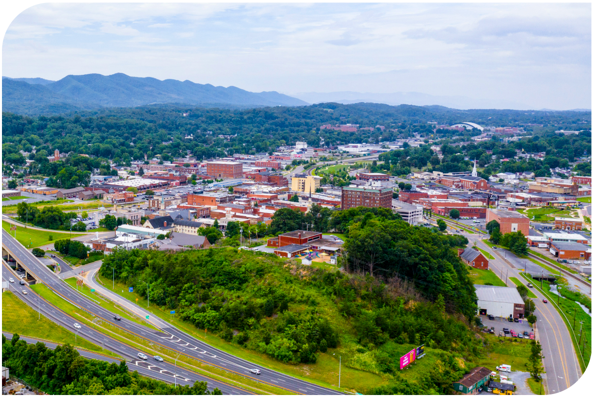
Appalachian Development Highway System (ADHS)
https://www.arc.gov/appalachian-development-highway-system/
Local Development District (LDD) Program
J-1 VISA Waiver Program https://www.arc.gov/j-1-visa-waivers/
Notes:
Lexi:
Additional priorities, programs, and activities of interest include:
The Appalachian Development Highway System (ADHS): ADHS is a 3,090-mile network of highways that enable economic growth and activity by linking the Region to national Interstates.
Local Development District (LDD) Program: A capacity-building program designed specifically for LDDs throughout the region to deploy technical assistance activities related to ARC funding opportunities.
J-1 VISA Waiver Program: A program that is rooted in ARC’s continuing commitment to help all residents of Appalachia access quality, affordable healthcare that allows ARC's Fed-Co to recommend a waiver of the foreign residence requirement for a physician holding a J-1 Visa under certain circumstances.

Slide 35





Connect with ARC
twitter.com/ARCgov
facebook.com/ARC.gov
instagram.com/ARCgov
linkedin.com/company/appalachian-regional-commission
arc.gov/newsletter-signup

Slide 36
Website Walk-Thru for Applicants www.arc.gov

Slide 37
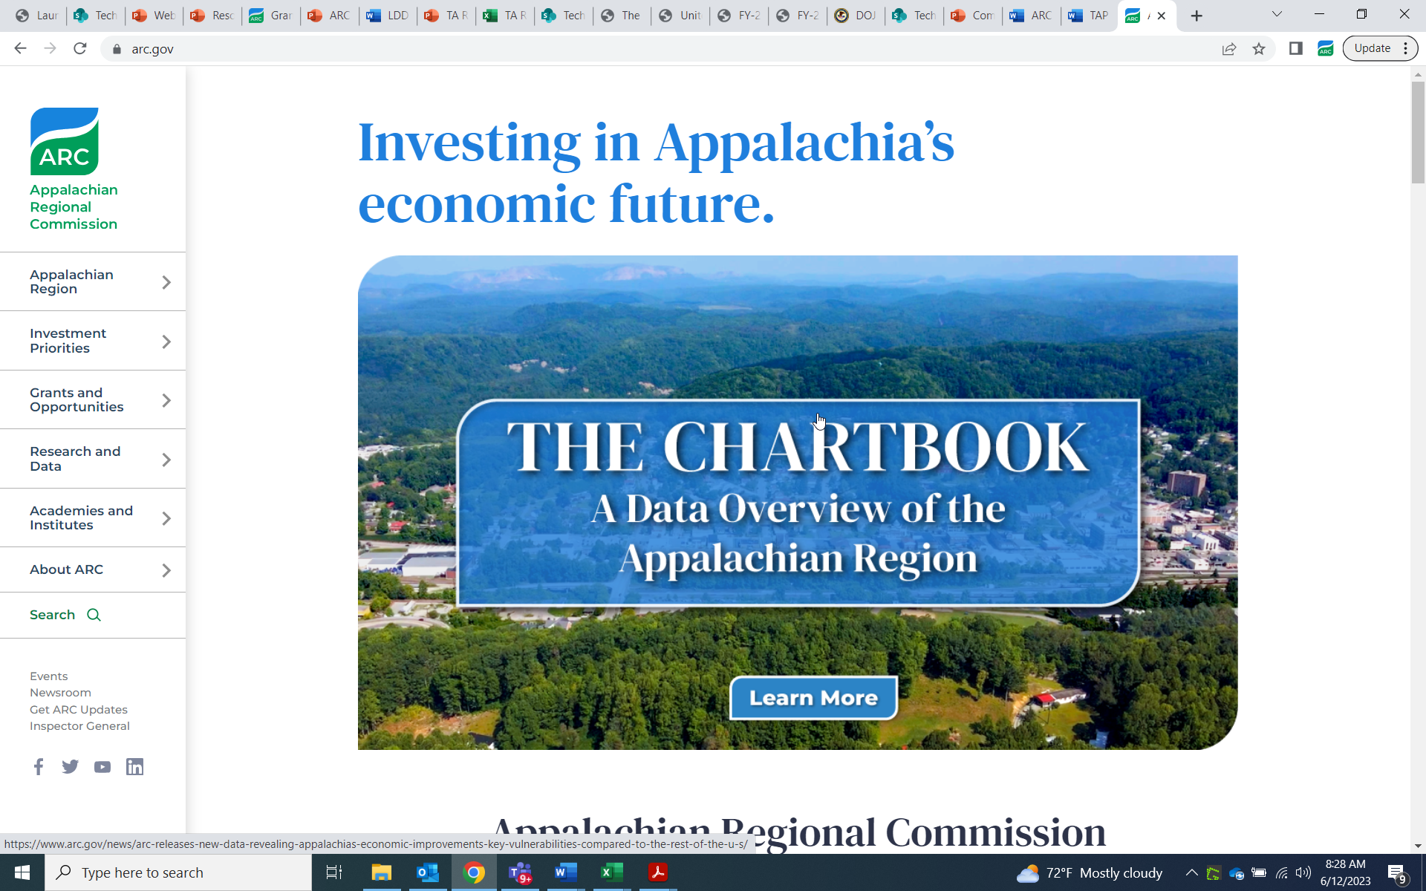
ARC.gov

Slide 38
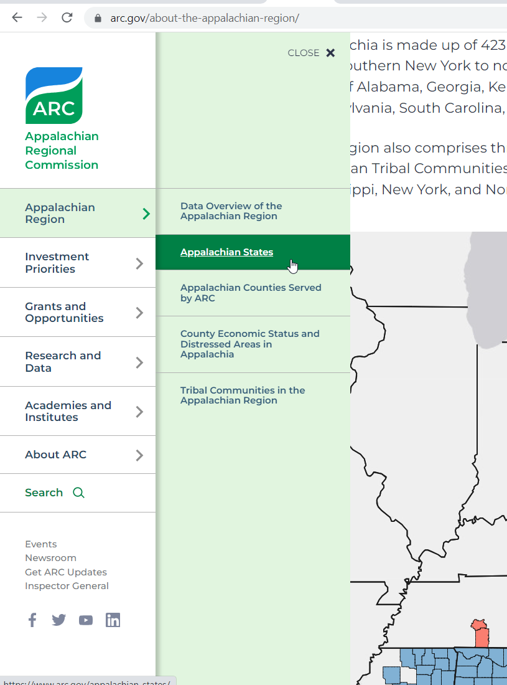
First Tab: High Level Overview and Background of the Region
Drop Down: Appalachian States
State-Specific Information including
ARC counties, county economic status, investment priorities, contact information, LDDs, and more.

Slide 39
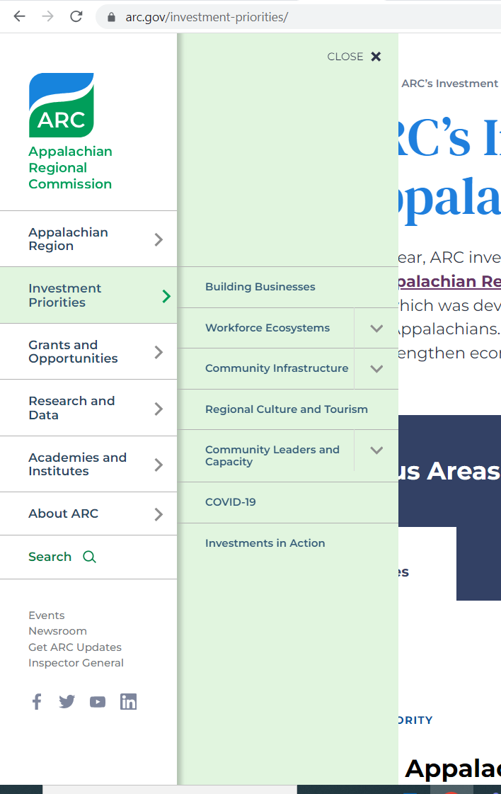
First Tab: High-Level look at ARC's Investment Priorities (aka strategic goals) including a link to ARC's Strategic Plan
Drop down: Deeper Dives into each ARC Goal Area
Rationale and purpose, different project types and examples, investment data and related statistics, related resources

Slide 40
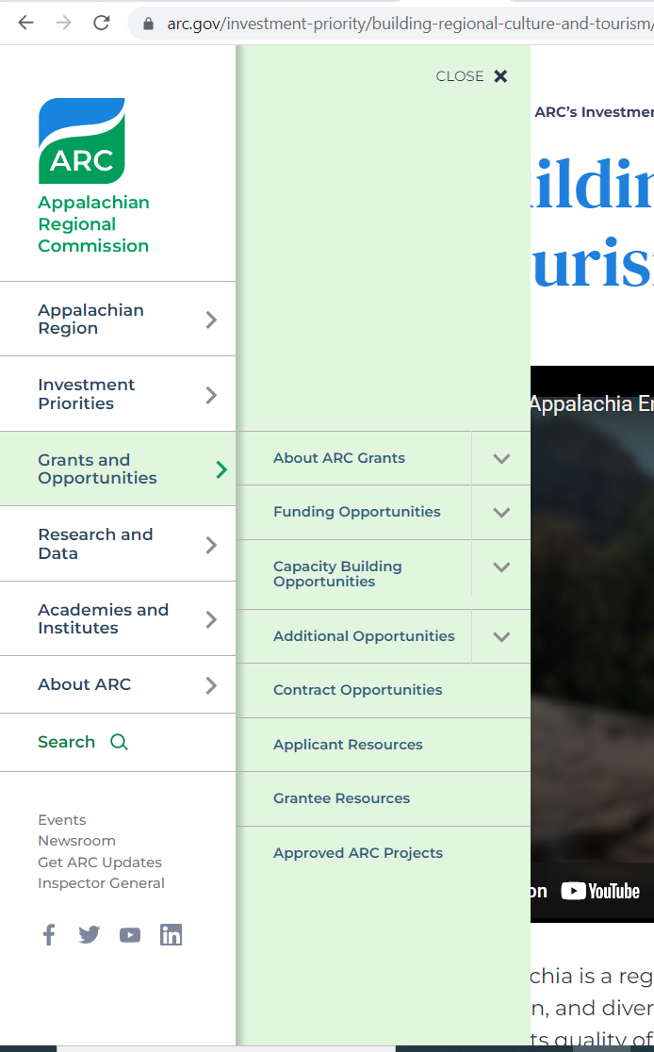
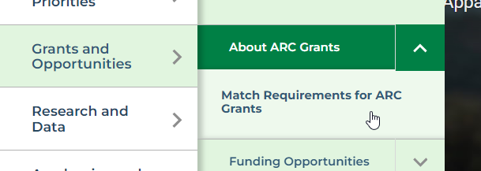
First Menu Option: About ARC Grants
General Eligibility Information
Drop Down: Remember the information on county economic status? This is why it matters.
Match Rates. How you calculate ARC/Applicant cost share.

Slide 41
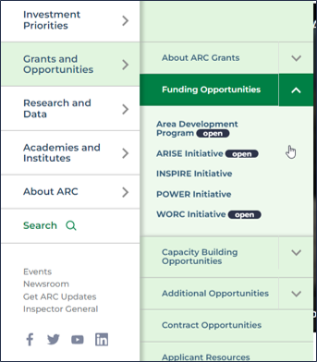
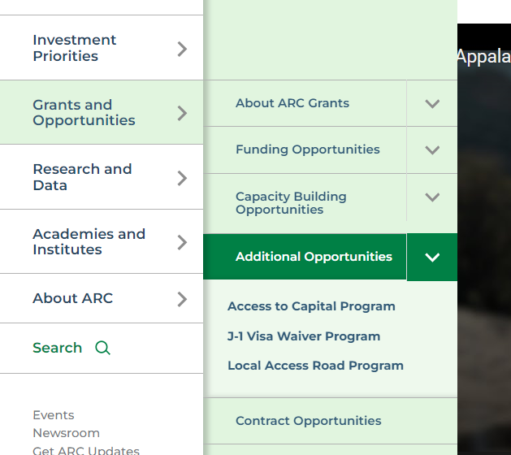
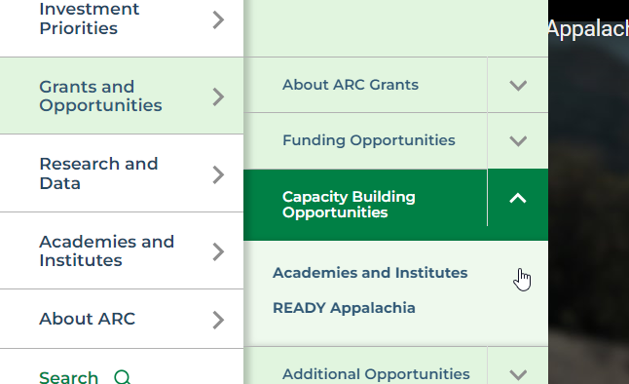

Slide 42
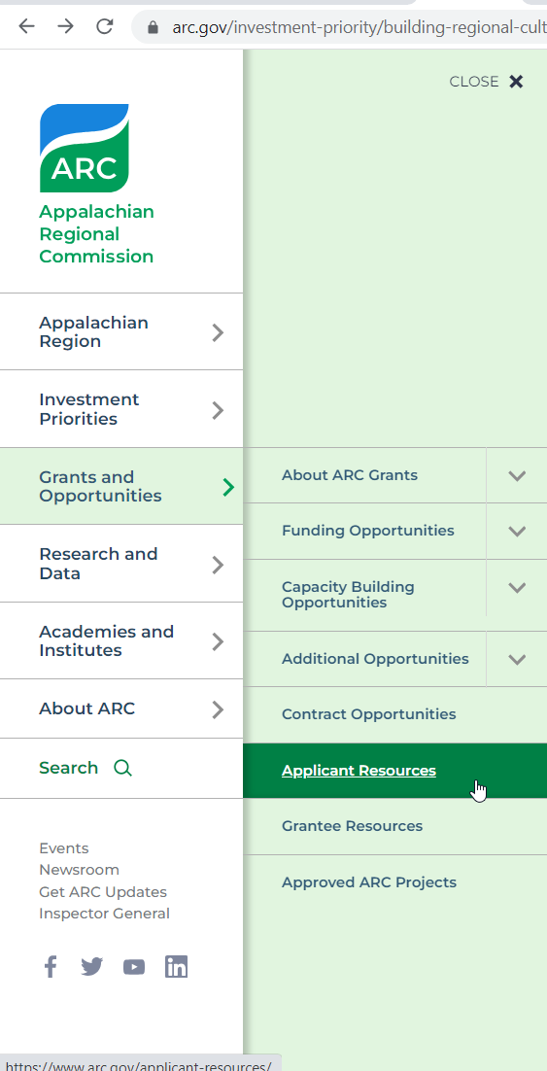
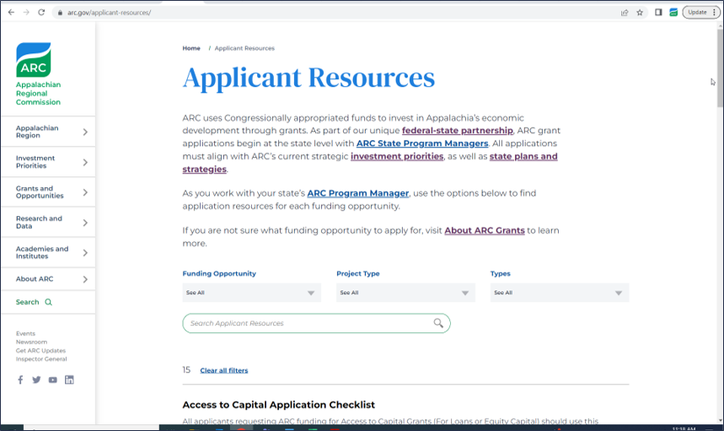

Slide 43
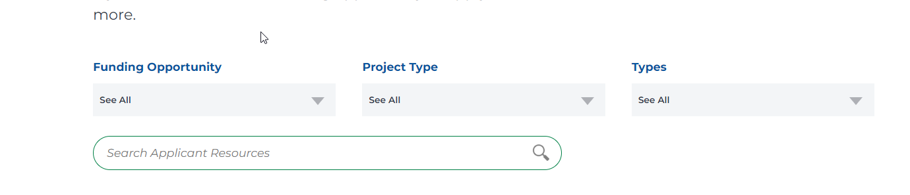
Toggleable search functions to narrow your scope!
Starting Point for Resources:
Area Development – Application checklist (non-construction/construction)
Access to Capital and Local Access Road Projects – refer to both checklists and guidelines
Other initiatives: Refer to NOSA (aka RFP, found on initiative-specific webpage) and corresponding checklist according to project type
Then go to find referenced material (forms, templates, etc.) contained within

Slide 44
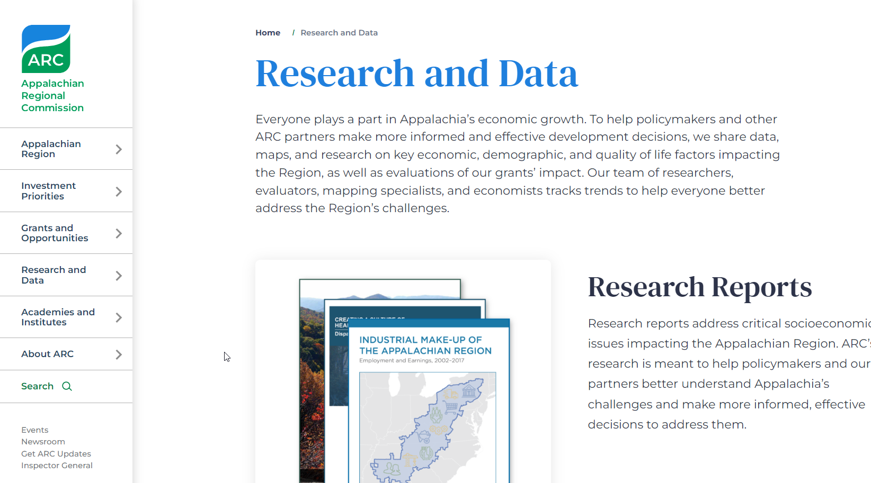
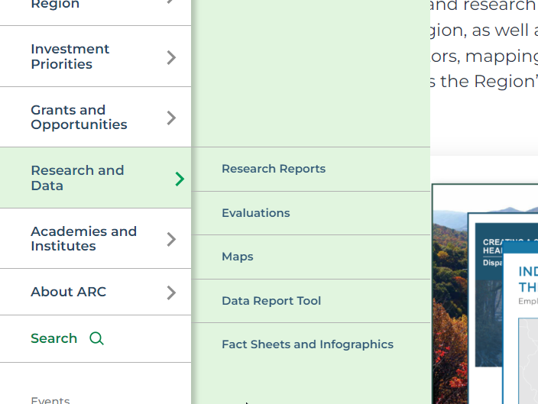
Filter to find the maps, data, evaluation, and associated research that will help support the strategic rationale.

Slide 45
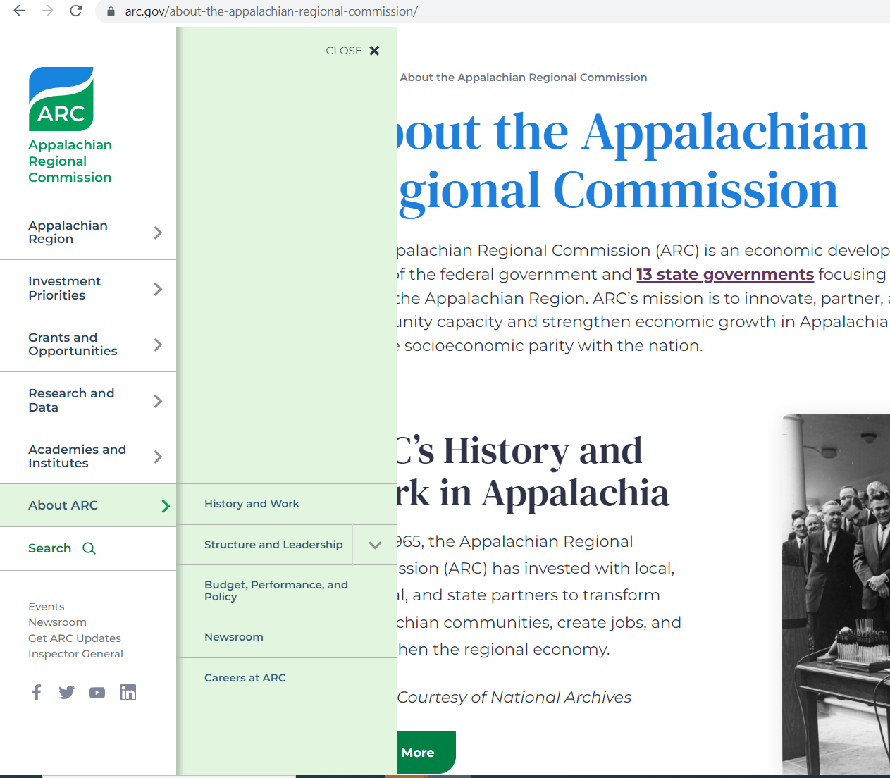
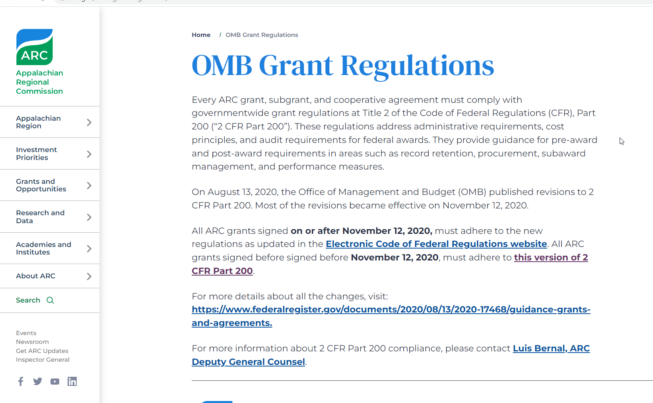
Grant Regulations
Applicable to all ARC funding recipients. It is the applicant's responsibility to learn, understand, and comply with the rules that govern their award

